Slide 1
Semantic Analysis of Email
By:
Mayur Kanojia
Sneha R.
Kum Somi

Slide 2

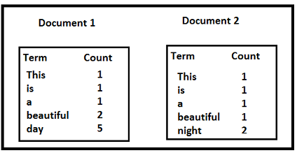
Text Data
33
This is a beautiful day

Slide 3
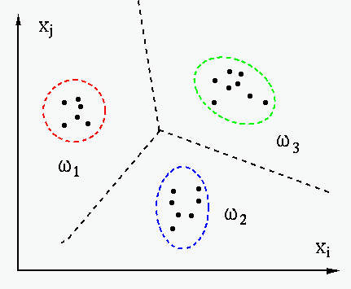
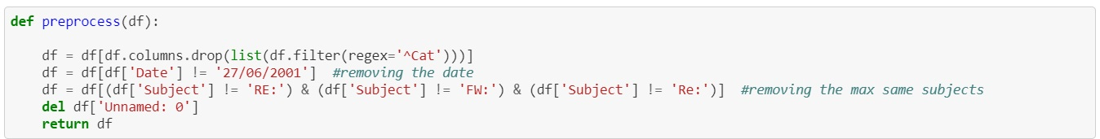
Feature Selection
Pre-processing:

Slide 4
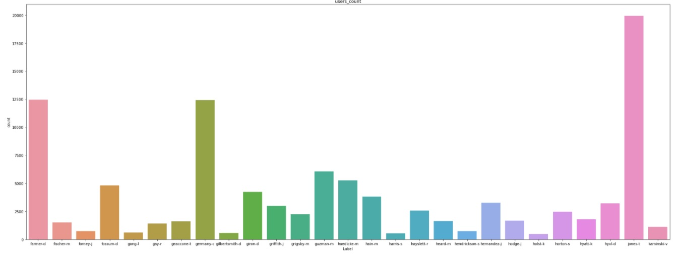

Slide 5
NLP Process
Remove Punctuation
Tokenization
Removing Stopwords
Stemming & Lemmatization
Vectorizing
1
2
3
4
5

Slide 6
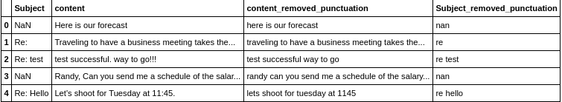
Removing Punctuation
rt

Slide 7
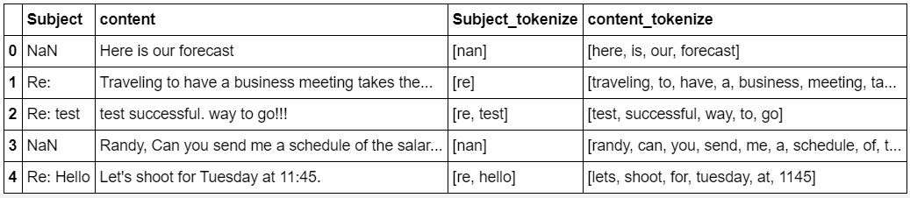
Tokenization
rt

Slide 8
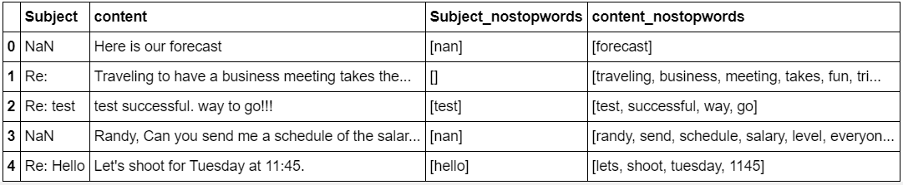
Removing Stopwords
ert

Slide 9
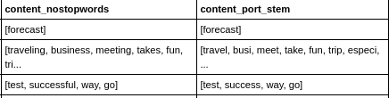
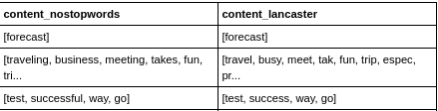
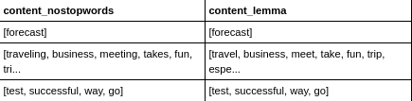
Stemming and Lemmatization

Slide 10
Vectorizing

Slide 11
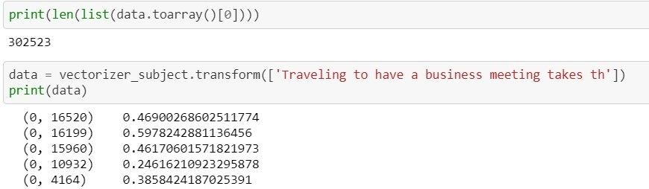
Vectorizing

Slide 12
Vectorizing
Document containing 100 words wherein the word 'Cauvery' appears 3 times. The term frequency (tf) for 'Cauvery' is then
TF = (3 / 100) = 0.03.
Now, assume we have 10 million documents and the word 'Cauvery' appears in 1000 of these. Then, the inverse document frequency (idf) is calculated as IDF = log(10,000,000 / 1,000) = 4.
TF-IDF = 0.03 * 4 = 0.12.

Slide 13
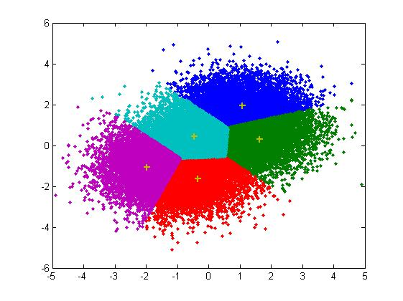
Clustering

Slide 14
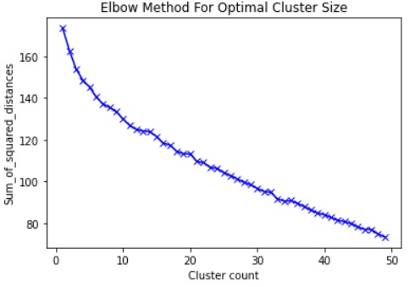
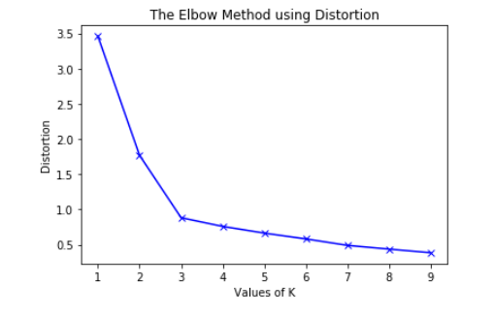
Elbow Method
tyuj

Slide 15
Clustering Output

Slide 16
Project Demo
Demo URL :- https://e137851e0db0.ngrok.io

